Slide 1
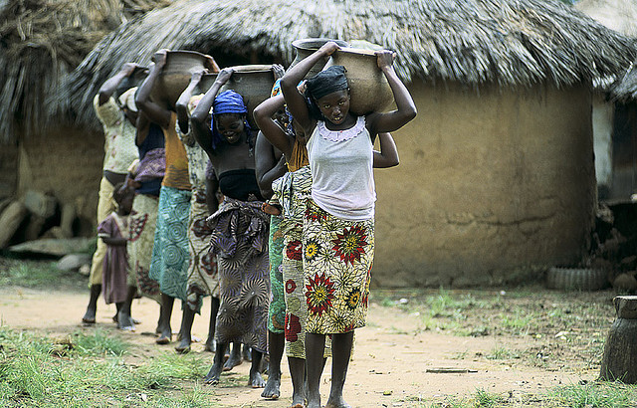
Water Finder Better water for more people

Slide 2
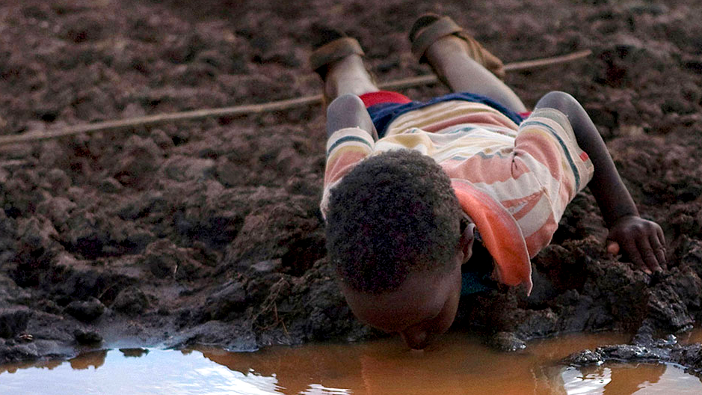
People are dying because of poor access to clean water
1 billion people lack access to clean water
17 million children will die this year from dirty water—more than those who will die from AIDS, Malaria, or war combined
Half of the world’s hospital beds are filled with people suffering from water-related diseases
Source: http://ithirst.org/why-water/

Slide 3
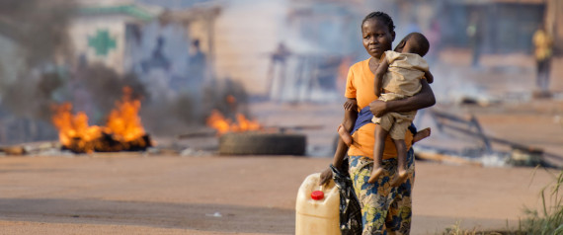
Why people don’t have access to clean water
People spend several hours a day walking to and from water sources
Water is contaminated
People don’t have information about the best water
Compounding factors make life even harder
Wars displace people
Social conflicts force people to migrate to areas they are not familiar with
Population is increasing

Slide 4
NGOs try to help, but…
Their information sources are stale and imprecise
They have often access to disjointed information stuck in silos
They don’t know precisely where the need is greatest
They don’t have a simple way to communicate with people in need

Slide 5
Common problems of water users and NGOs
Information sources are not shared
There’s little communication between individuals and NGOs about
What water sources are closest to individuals
What water sources are clean
Where water is needed
Meanwhile, 30% Africans are expected to have access to smartphones by 2017
Companies like Facebook (drones) and Google (balloons) are working on ways to bring the Internet to the next billion people.
Source: Africa Telecoms Outlook, http://files.informatandm.com/uploads/2013/11/Africa_Telecoms_Outlook_Low_resolution.pdf

Slide 6
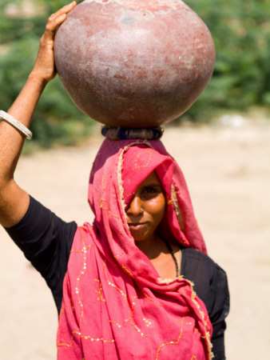
Amina’s plight
Recently displaced by the war in Yemen
Searches for a clean water source every day
Walks 4 miles to and from the good water source
Her children have been sick with dysentery 6 times in the last year
She has to choose between time with her sick children or time collecting water
She is stuck in the cycle of being displaced

Slide 7
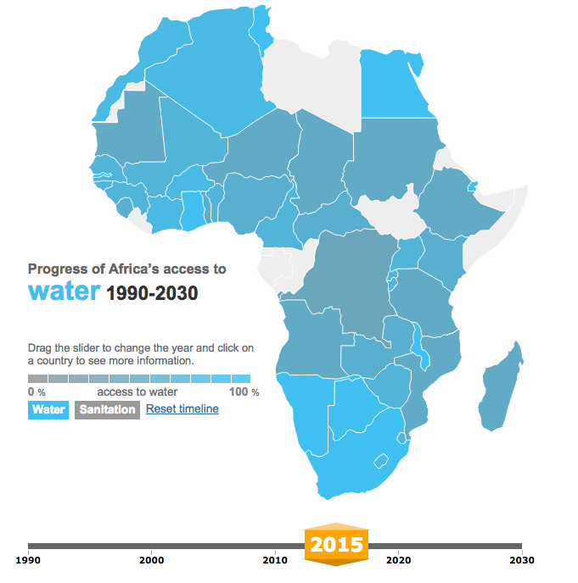
Mary’s mission
Works for a non-governmental organization in Washington, DC that helps people find water
Uses reports that are several years old
Has data at the country level
Coordinates efforts with other NGOs
Doesn’t know where and when Amina needs water
Source: http://www.theguardian.com/global-development/ng-interactive/2014/may/28/africas-water-the-path-to-universal-access-interactive

Slide 8
Water Finder solves Amina’s problem
Identifies the best locations for clean water
Identifies if water is suitable for drinking, cleaning or animals
Reduces wait times at the pump
Sensor data
Water
Finder
Amina
Best water source
Distance

Slide 9
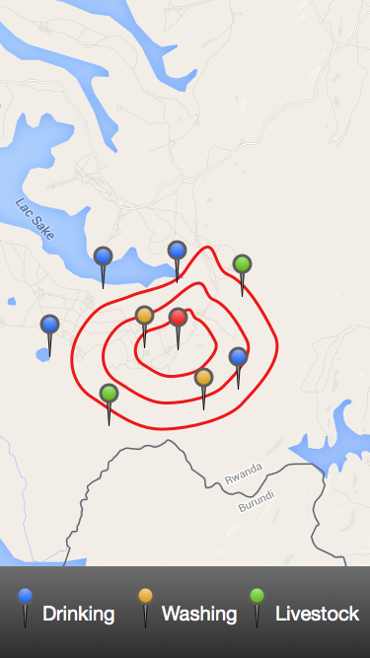
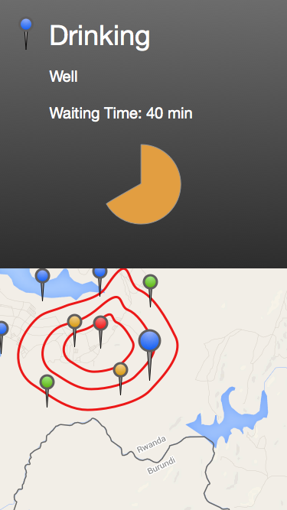
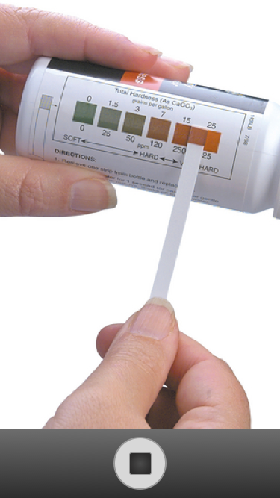
Amina: Water Finder app
Nearest Locations
Walking time
Water source Info
Waiting Time
Low cost sensors:
On site Testing
Result uploads

Slide 10
Water Finder solves Mary’s problem
Receives data about the location and quality of water
Provides data and tools to Amina
Predicts areas where more people will need water
Location of sick people
Sensor data
Water
Finder
Water users
Quantity of water needed by location
Distance
Locations to deploy sensors

Slide 11
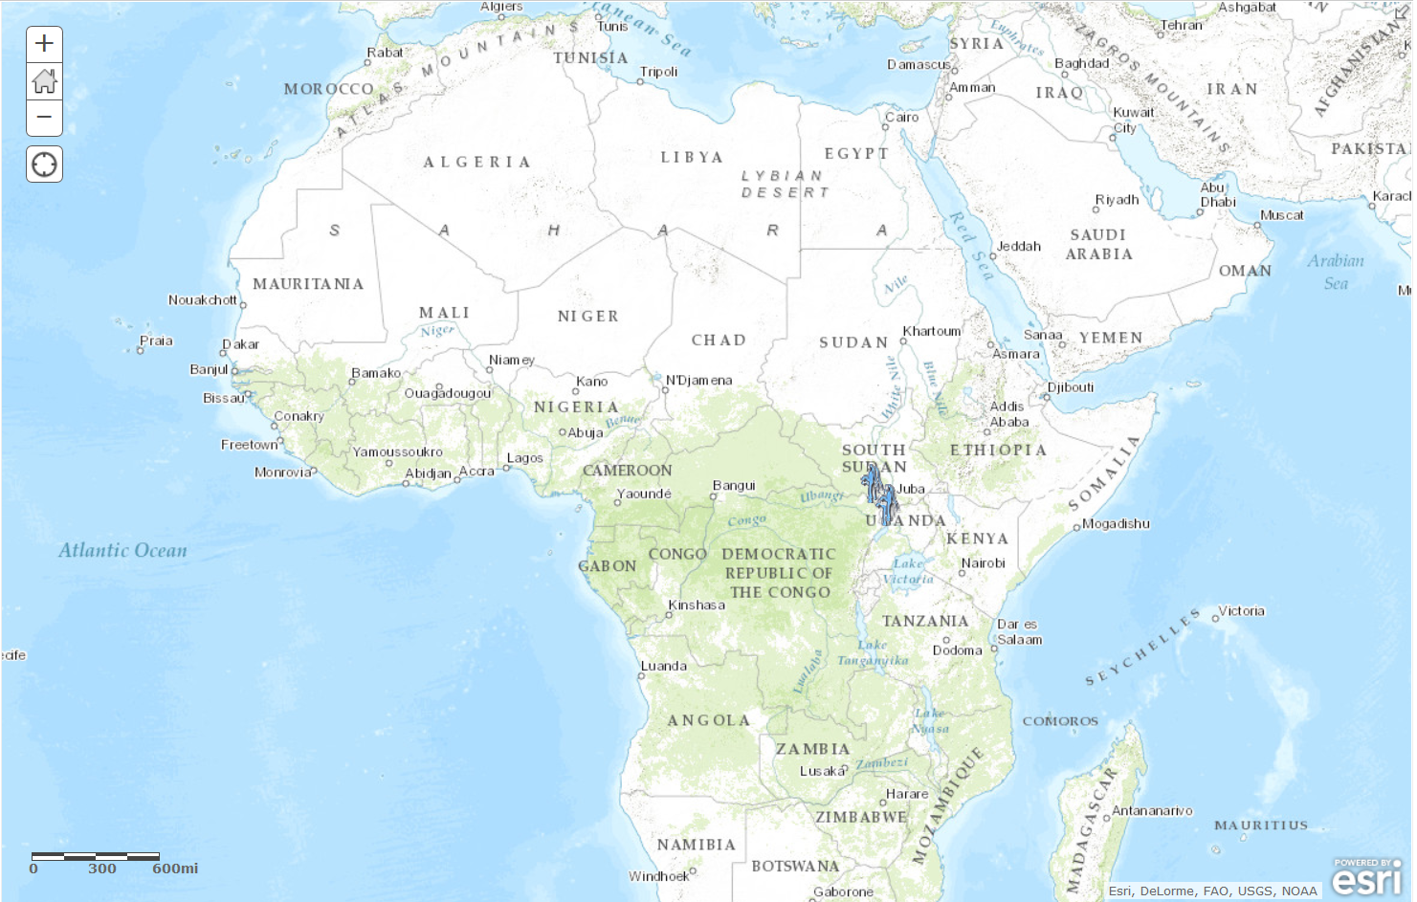
Mary: Water Finder Tools & API
Integration with widely used geocoding tools

Slide 12
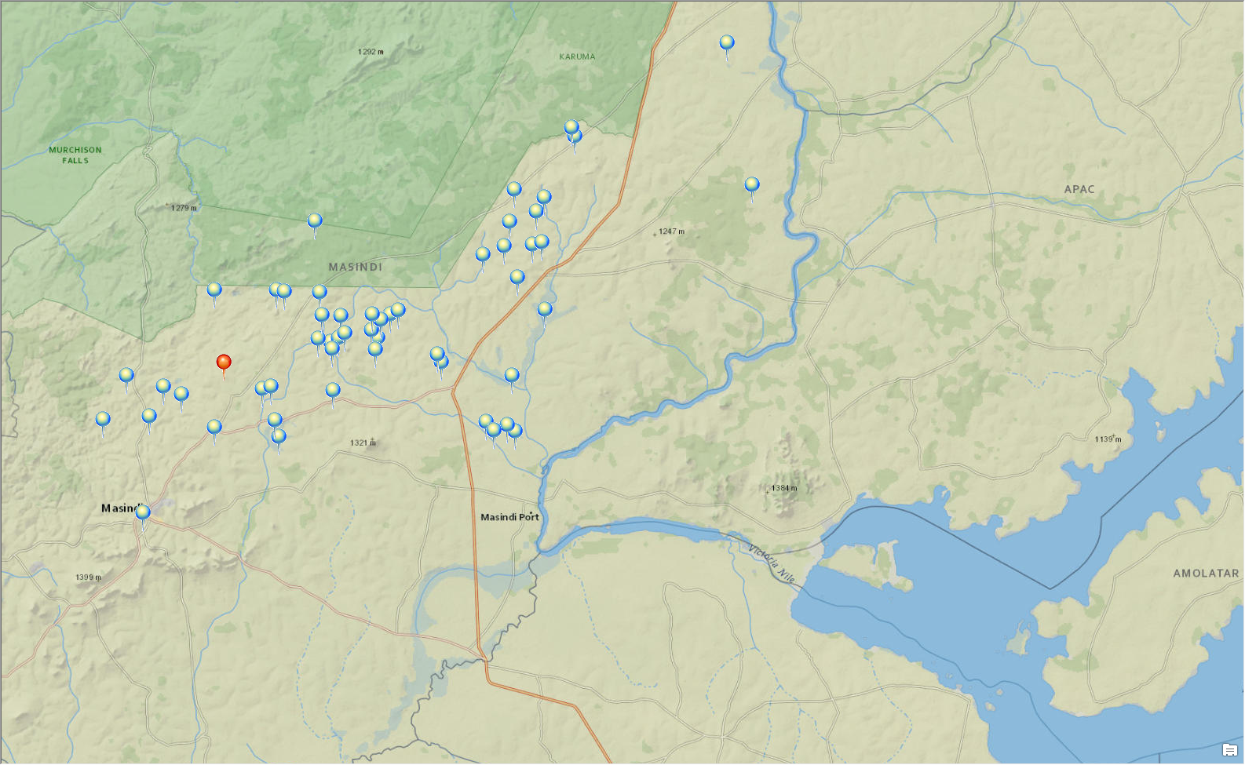
Mary: Water Finder Tools & API
Live information
Pattern Finder
Prediction Analysis
Imminent Water Shortage

Slide 13
Mary: Water Finder Tools & API
Water Finder
End User
Super User
Amina
Mary

Slide 14
Future directions for Water Finder
Seek partnerships with NGOs that could use and adopt Water Finder
Approach potential funders (e.g., Google, Facebook, Department of Defense) about commercializing Water Finder
Seek partnerships with other developer teams
Test with users in the US and in countries in need
Share our code and ideas online and ask others to expand Water Finder’s capabilities
Apply data from SMAP

Slide 15
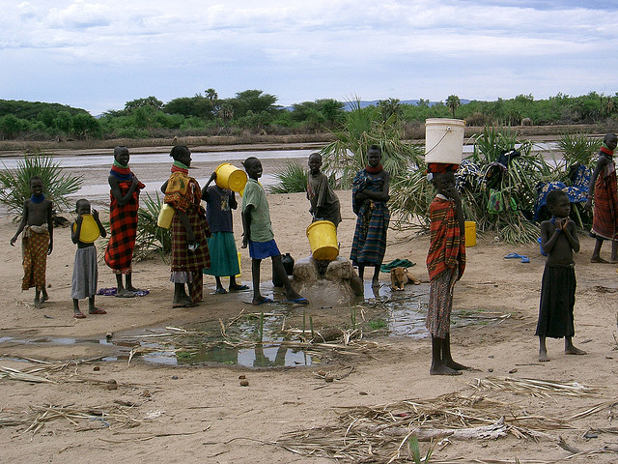
Water Finder Better water for more people

